Slide 1
AP University of Applied Sciences & Arts
Introduction

Slide 2
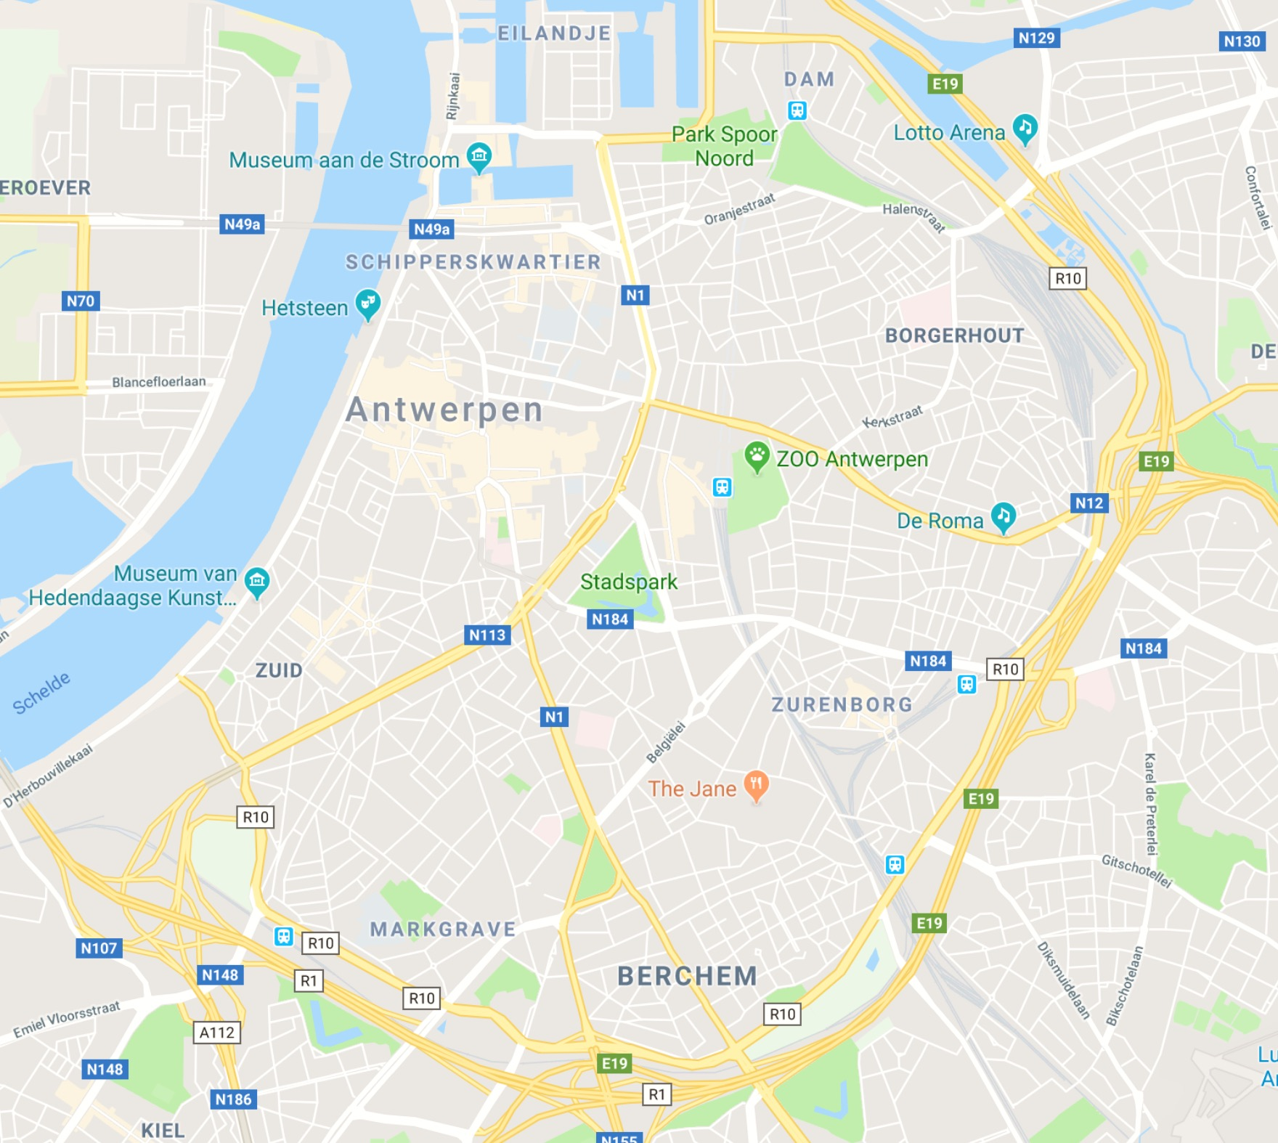
Approx. 16.000 students
Facts &
Figures
AP University of Applied
Sciences and Arts
2 Schools of Arts & 6 Faculties
7 campuses in the centre of Antwerp

Slide 3
Graphic & Digital Media
Introduction

Slide 4
JAAR 1
JAAR 2
JAAR 3
SEM 1
SEM 2
SEM 3
SEM 4
SEM 5
SEM 6
MOTION
MOTION
MOTION
MOTION
MOTION
STAGE
PUBLICATION
PUBLICATION
PUBLICATION
PUBLICATION
PUBLICATION
STAGE
BRAND
BRAND
BRAND
BRAND
BRAND
STAGE
INTERFACE
INTERFACE
INTERFACE
INTERFACE
INTERFACE
STAGE

Slide 5
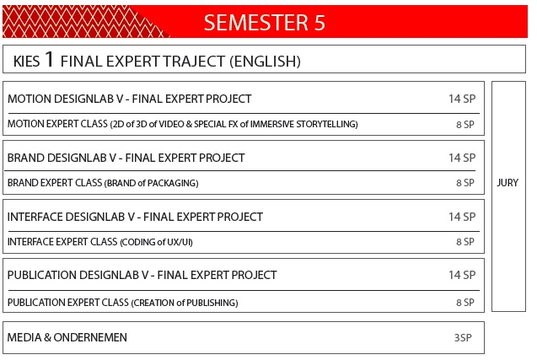

Slide 6
Exchange Opportunities
Semester 5:
English study program
Expert project (Brand, Motion, Publication or Interface) (14ECTS)
2 x Expert Classes (2 x 8 ECTS)
4_Friskies rebranding opdracht (2GDM) on Vimeo

Slide 7
Exchange Opportunities
Semester 6:
EPS (European Project Semester)
whole semester (30 ECTS)
international & multidisciplinary project
project (20 ECTS) + supplementary courses (10 ECTS)
European Project Semester (EPS) | AP Hogeschool

Slide 8
AN INNOVATION LAB FOR FUTURE PROFESSIONALS
EPS
International
Interdisciplinary
(technological world meets non-technological world)
Real-life projects
Team work

Slide 9
Antwerpen
Introduction

Slide 10
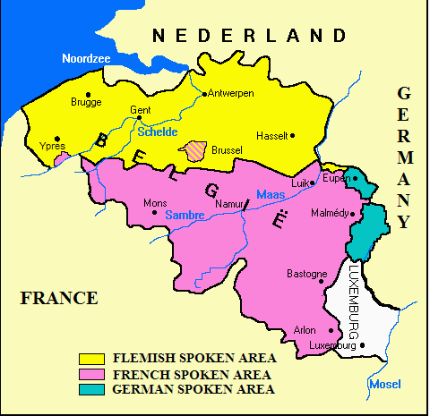
Belgium
One country three languages

Slide 11
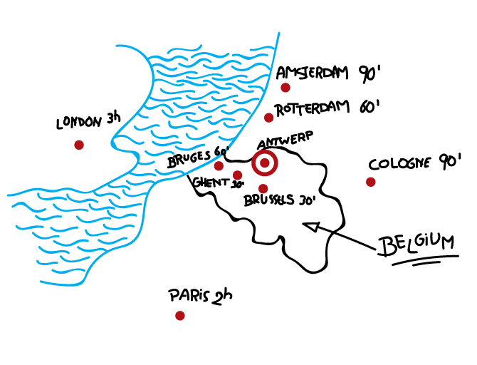
Notes:
In between art department & communication

Slide 12
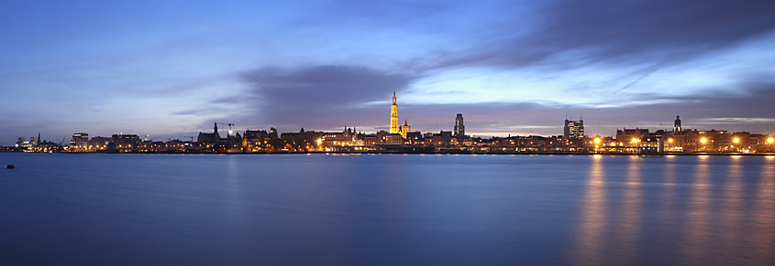
ANTWERP
Antwerp is a very old city, situated near the river Scheldt

Slide 13
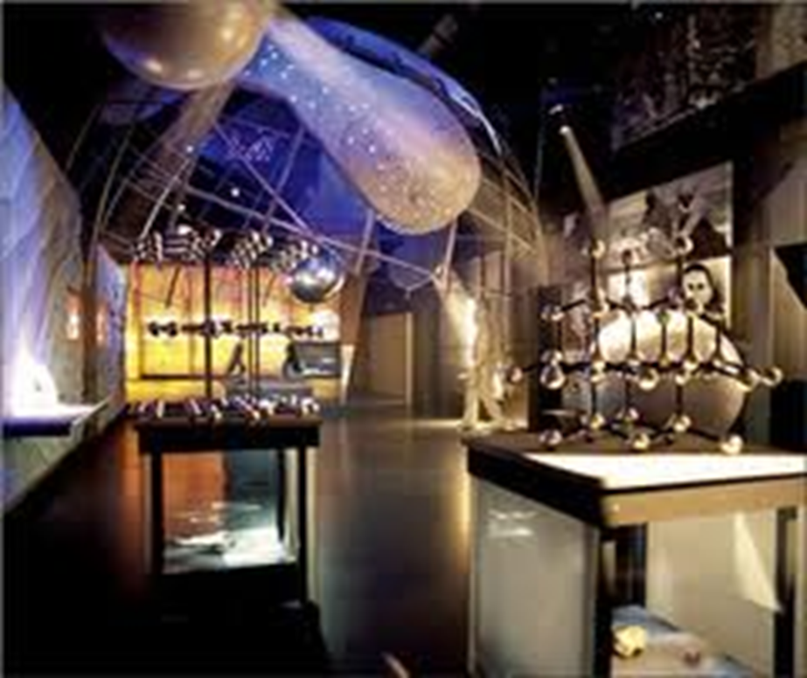
Antwerp: Seaport and Diamonds

Slide 14
Antwerp Fashion
Exciting new fashion
Famous names:
Dirk Bikkembergs
Dries Van Noten
Walter van Beirendonck
Ann Demeulemeester ...
→ all AP alumni

Slide 15
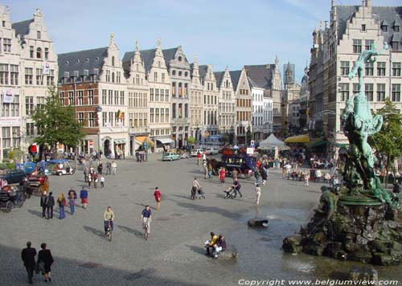
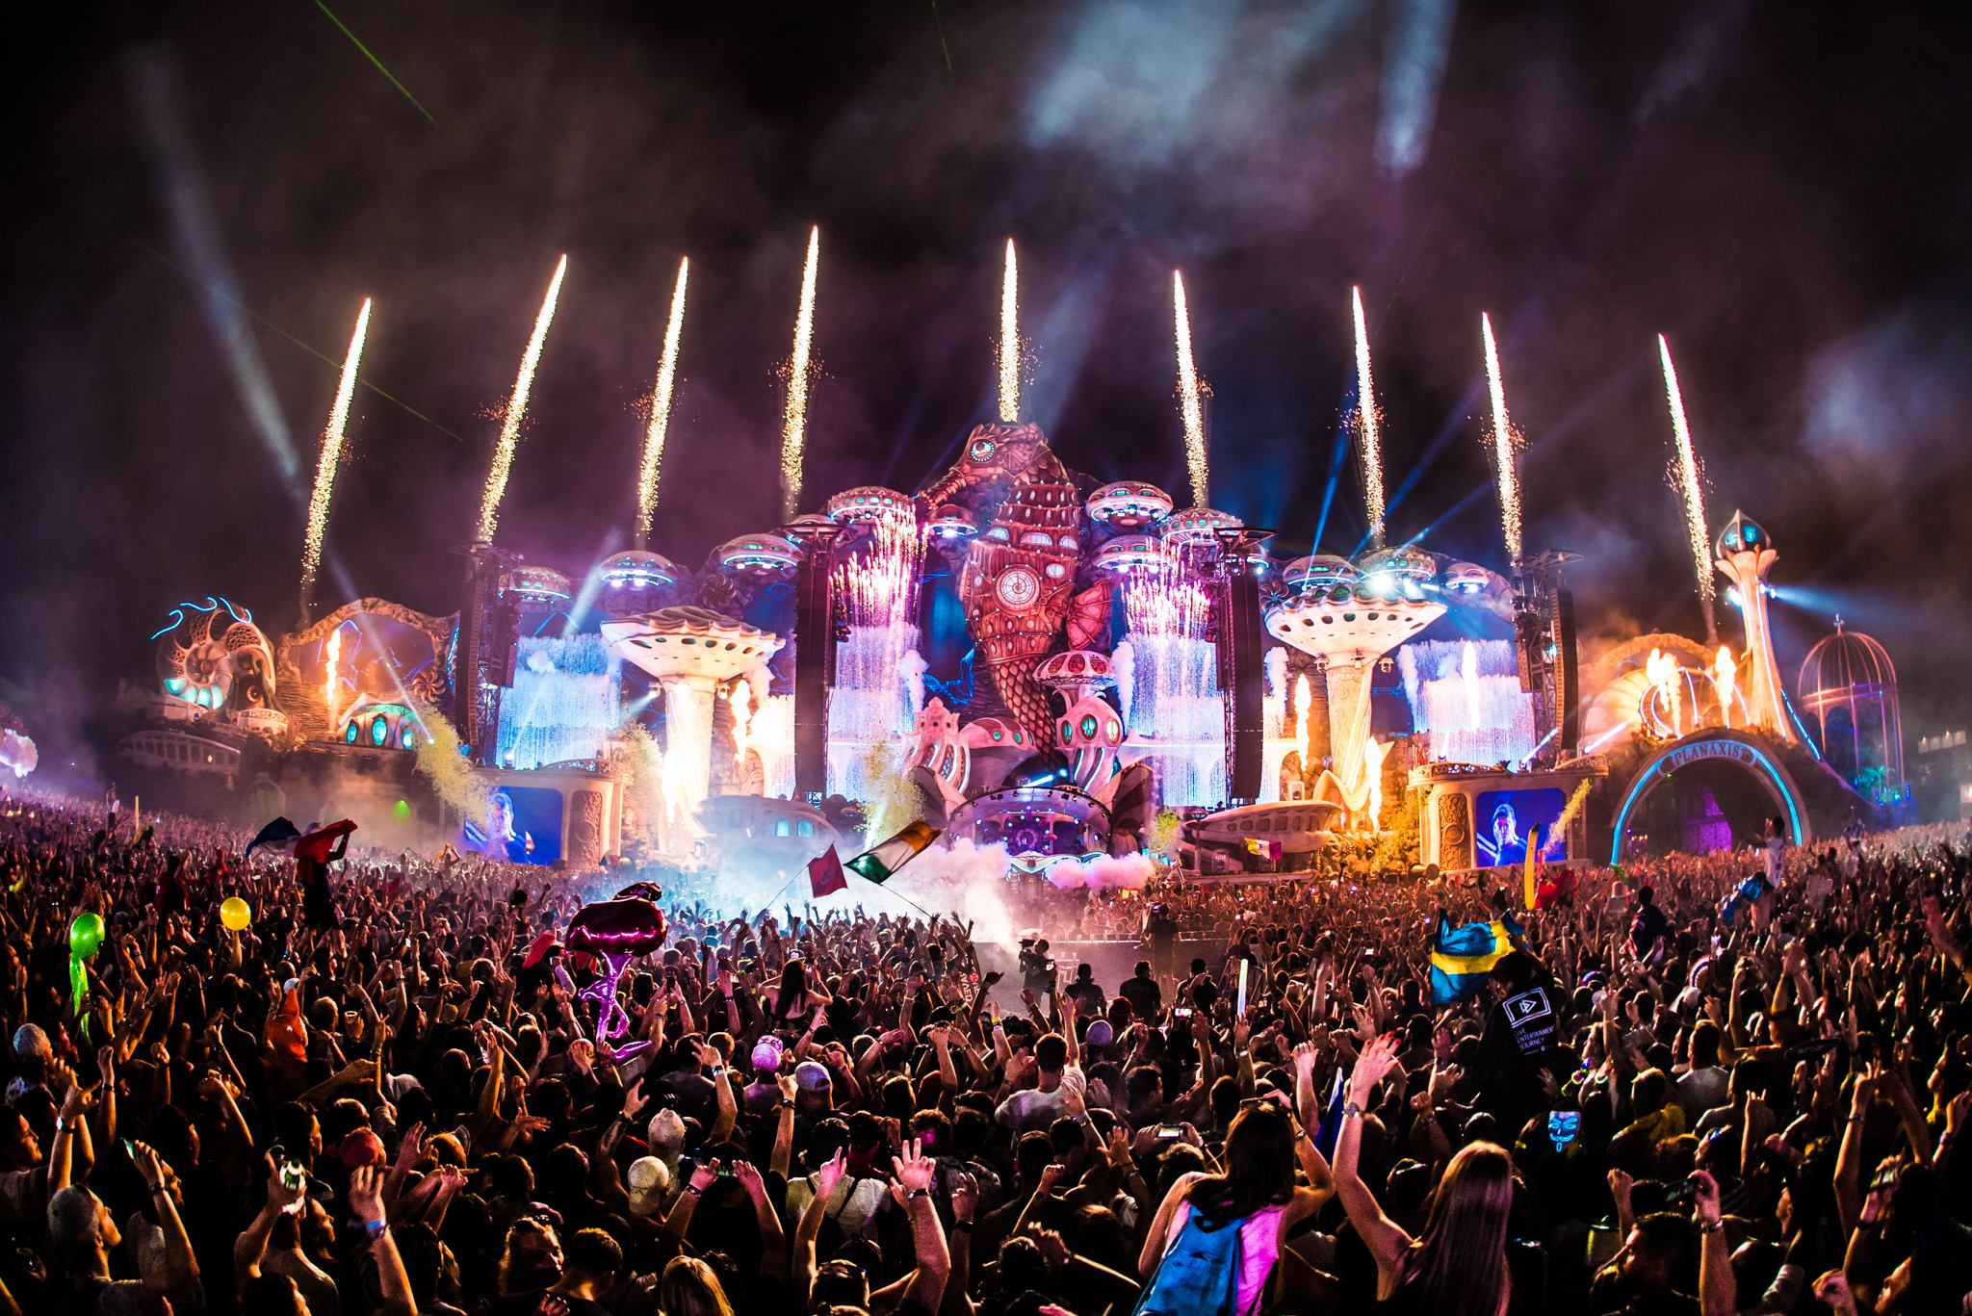
Antwerp is art and culture
Museums with paintings of great Antwerp painters Rubens, Van Dyck, Jordaens …
A large number of historical houses and buildings
Grote Markt = Central Square
An exciting music & art scene (Tomorrowland, dEUS, ...)

Slide 16
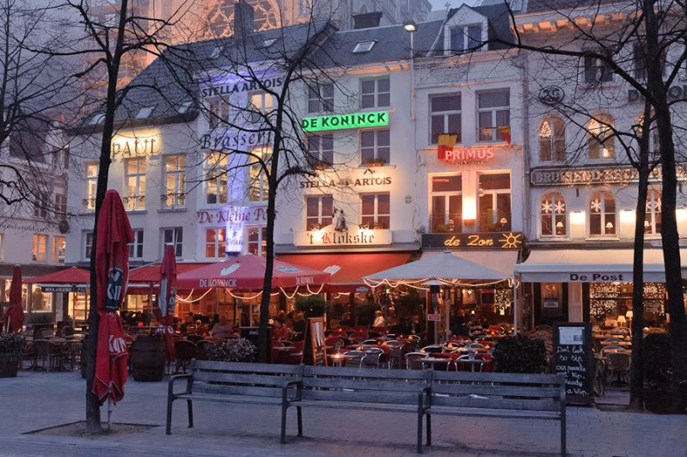
Antwerp is fun
Innumerable indoor and street cafés, each with their own character
Hundreds of restaurants of all categories
Busy shopping streets
All kinds of temptations, including Belgian beers & delicious Belgian chocolates
Atypical Antwerp - YouTube

Slide 17
Fragen/Questions erwin.listhaeghe@ap.be

